Slide 1
LUGGAGE SECURITY ALARM By
Mini-Project Phase-01
PRESENTATION
ON
Student Name USN
Divya Shree R 1NH18EC711
Sowmya G 1NH18EC714
Sharanya K N 1NH18EC747
Devika K 1NH18ME037
Guided By
Ms. Rajani
Assistant Professor
Dept. of ECE
New Horizon College Of Engineering

Slide 2
INDEX
Introduction
Literature Survey
Aim and Objectives of Project
Top Level Block Diagram
Project Description
Progress Work
Milestones/Schedule
Outcome of Project
References

Slide 3
INTRODUCTION
During our journey through train and bus, we carry many important things and all the time we have fear that someone might lift our luggage.
To overcome with these fears here is an easy circuit which is based on the NAND gate.
Luggage Security Alarm produces a warning beep, when someone tries to unlock the lock.
3

Slide 4
LITERATURE REVIEW
Paper No | Title | Author & Year of Publication | Outcome | Limitation
1. | Power Line Channels Characteristics And Their Effect On Communication System Design | Gotz.M ; Rapp.M ; Dostert.K | High-speed communication purposes | Noise added by PLC is more
2. | Wireless Sensor Networks for Water Quality Monitoring: A Case of Zambia | Chaamwe, N | Wireless Sensor Networks to monitor water quality using cheap, effective and efficient sensors | Efficiency is very less
3. | Analysis of effect of power line channel characteristic parameters in broadband power line communication (BPLC) systems. | Surekha, T.P. ; Ananthapadmanabha, T.; Puttamadappa, C. | The analysis presented here is helpful in the design of BPLC systems for a better data transfer and system performance | Due to high data transfer, The BW usage is very Less
4. | A new wireless network approach for high speed communication services. | Hernández-Valdez, G. ; Cruz-Perez, F.A. ; Lara-Rodriguez, D. | The coverage delay in both Info stations and Intermit stations systems is mathematically analyzed | Data rate is compromised
5. | Novel Planar Electromagnetic Sensors for Detection of Nitrates and Contamination in Natural Water Sources | Yunus. M.A.M ; Mukhopadhyay.S.C | The outcomes show a very good correlation of contamination level with the output response of the sensor | Efficiency of sensor used is less

Slide 5
AIM and OBJECTIVE
AIM : Construct a luggage security alarm circuit based on NAND
gate.
Objective:
1.It uses components like resistors, capacitors, transistors and so on which are available easily.
2.Low cost.
3.Functioning of these circuits is very easy.
4.To provide safety.

Slide 6
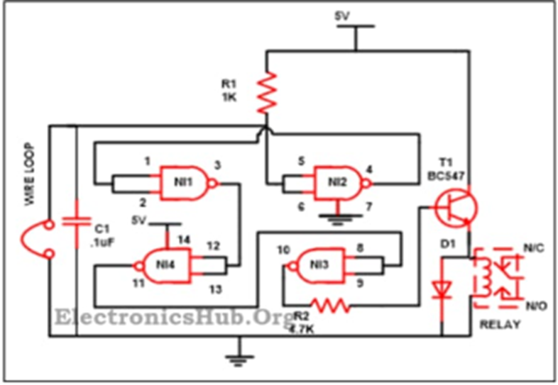
TOP LEVEL BLOCK DIAGRAM

Slide 7
PROJECT DESCRIPTION
The basic building block of this circuit is CD4011 along with resistors, capacitors, transistor and relay.
Output is based on the voltage on pin 5. At that time when power supply is attached to the circuit pin 5, voltage is at zero as loop is unbroken, hence at pin 4 voltage is high which is coupled with pin1 and pin 2 which is also at high state.
As u can also find from the truth table of the NAND gate that if the both the I/p are at high state then the o/p is low, hence at pin 3 at gate 1, we get low which is once more attached to pin 12 as well as 13 moving them also to the low which in turn makes the pin 11 to switch at high switching pin 8 as well as pin 9 also at high and low voltage at pin 10 due to the transistor linked it via a resistor will not be boost the base of it and the alarm will not receive by us. This implies that our baggage is secure.

Slide 8
PROGRESS WORK
1.We have researched about our project.
2.Components purchased.
3.Working on real time implementation and testing our circuit.

Slide 9
Milestones/Schedule
Table A - Milestones scheduled for achievement and performance against those milestones:
Milestone | Baseline Date | Target Date | Achievement
Discussion about abstract | 23/8/19 | 2/8/19 | Discussion was positive
Submission of abstract and ppt | 28/9/19 | 28/9/19 | Modification was done as per discussion
Submission of abstract | 30/9/19 | 30/9/19 | Accepted
submission of ppt | 14/9/19 | 14/9/19 | Accepted
Required Components | 10/9/19 | 10/9/19 | Components purchased

Slide 10
Project Work Distribution
Name of Team Member | Work distributed
DIVYA SHREE.R | RESEARCHING ON THE TOPICS
SOWMYA.G | PRESENTATION
SHARANYA.KN | ABSTRACT AND CIRCUIT
DEVIKA.K | COMPONENTS PURCHASED AND RESEARCH ABOUT THE TOPIC

Slide 11
OUTCOME OF PROJECT
To test the working of luggage security
alarm.
11

Slide 12
REFERENCES
1.ElectronicsHub.Org
2.https://www.edgefxkits.com/blog/luggage-security-alarm-system-applications/
3.

Slide 13


